Slide 1

Google TuniX
Hackathon
Training a 2B Parameter Model to Reason
Achieving 71.3% Accuracy on GSM8K
Rohan Sanjay Patil, Vidya Padmanabha, Harsha Satish, Riya Biju
G NotebookLM

Slide 2
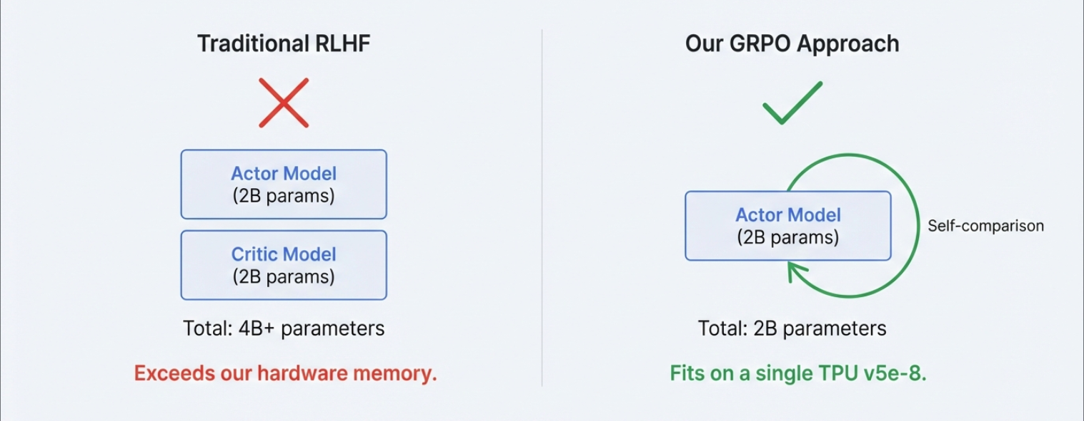
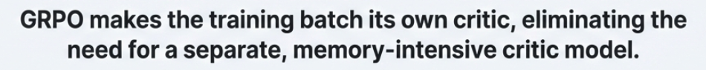
The Constraint: Why GRPO?
The Constraint: Why GRPO?

Slide 3







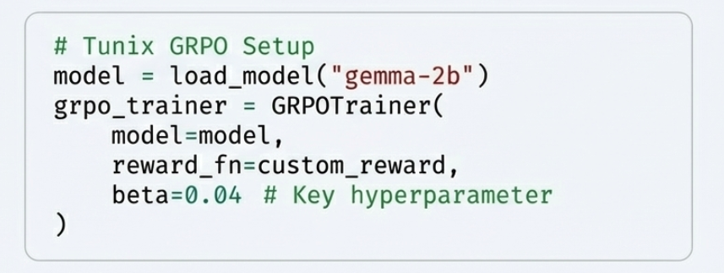
The GRPO Process: A Self-Correcting Loop
Generate Completions
Score Against Each Other
Learn from the Best
Problem
G Nc•tebookLM

Slide 4
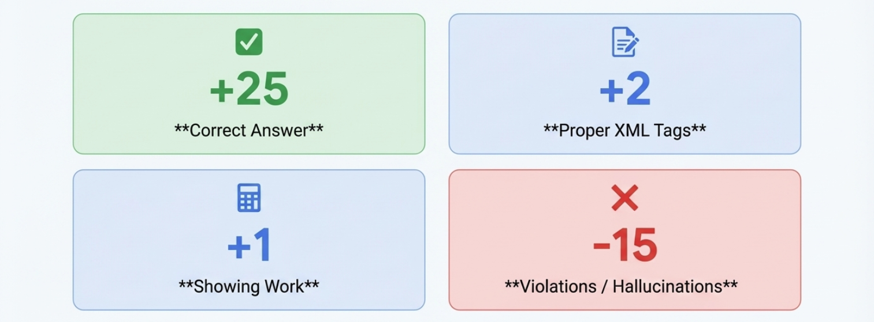
Rewarding the Process, Not Just the Answer

Slide 5
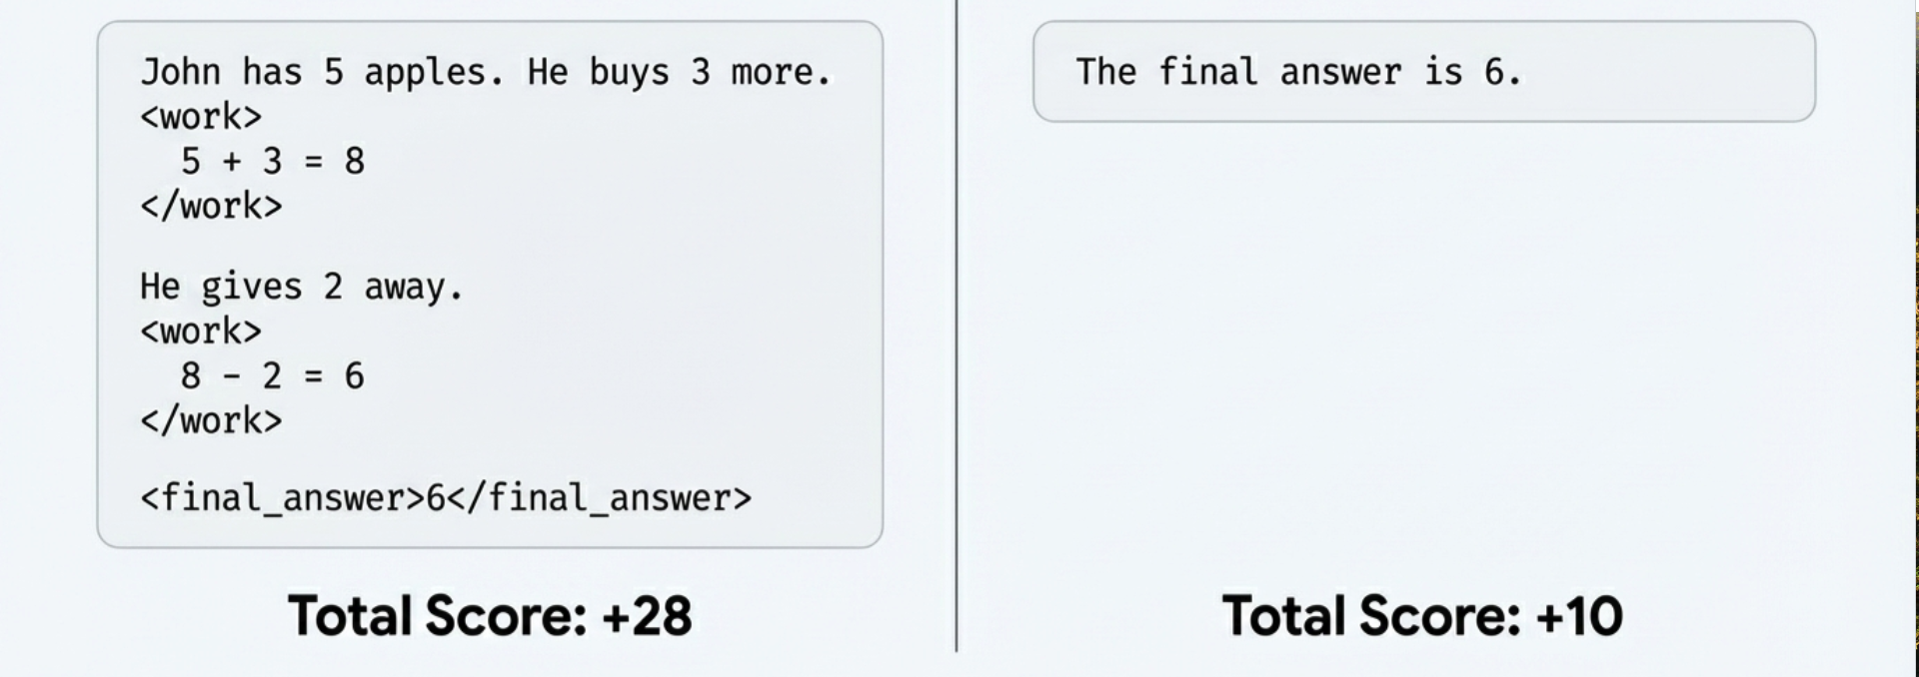
Good vs. Bad Reasoning: A Practical Example
Good Output Bad Output

Slide 6
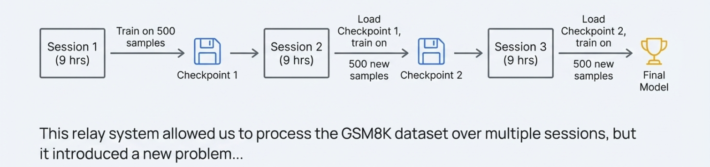
The Marathon: Multi-Session Training

Slide 7
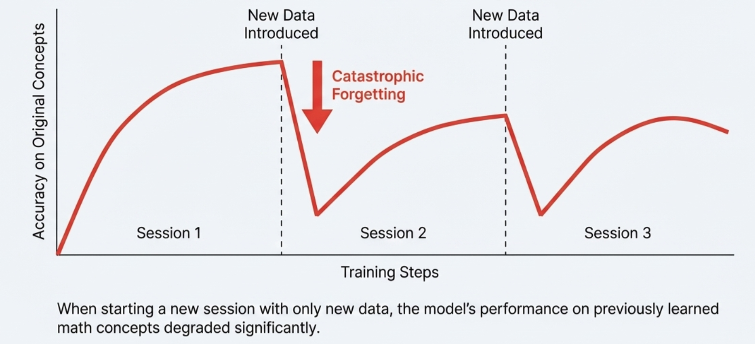
A New Problem Emerges: Catastrophic Forgetting

Slide 8
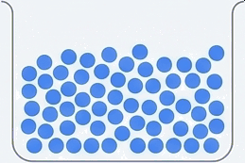
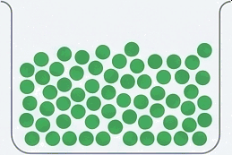
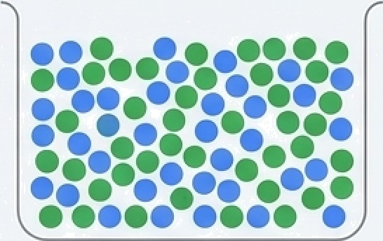

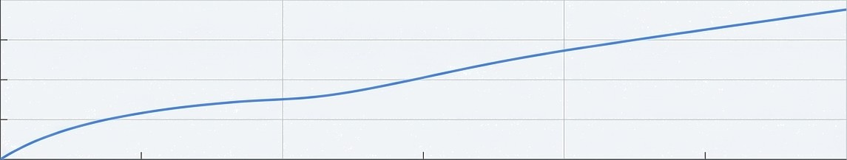

The Solution: Active Review
5 0 0 New Samples
5 0 0 Old Samples (Random)
1000 Sample Training Batch
Session 1
Session 2
Training Steps
Session 3

Slide 9
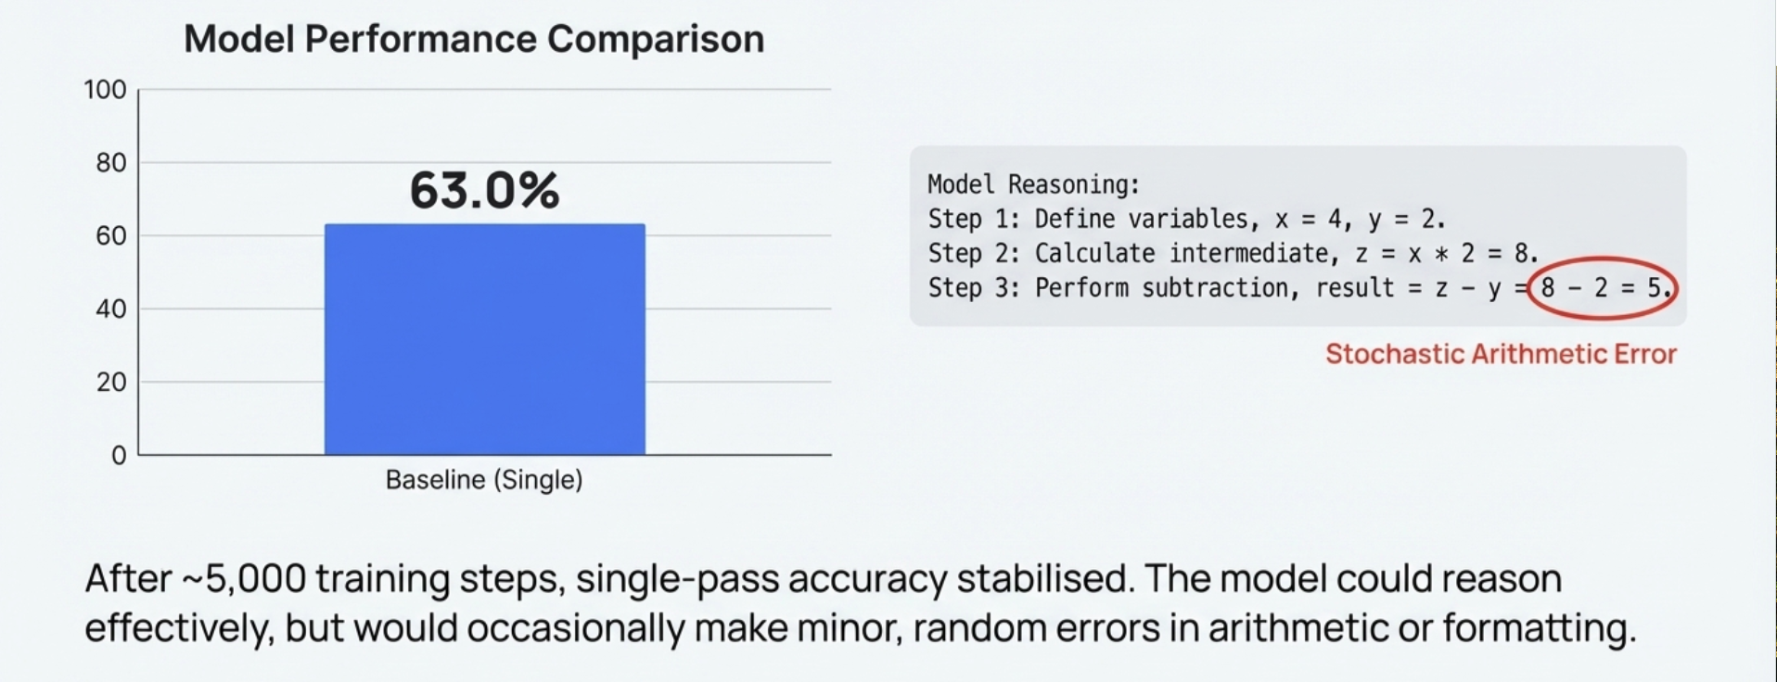
The Plateau: Reaching the Baseline Limit

Slide 10
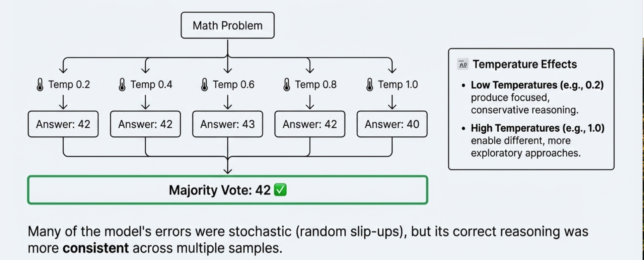
The Breakthrough: Boosting Reliability with Consensus Voting

Slide 11
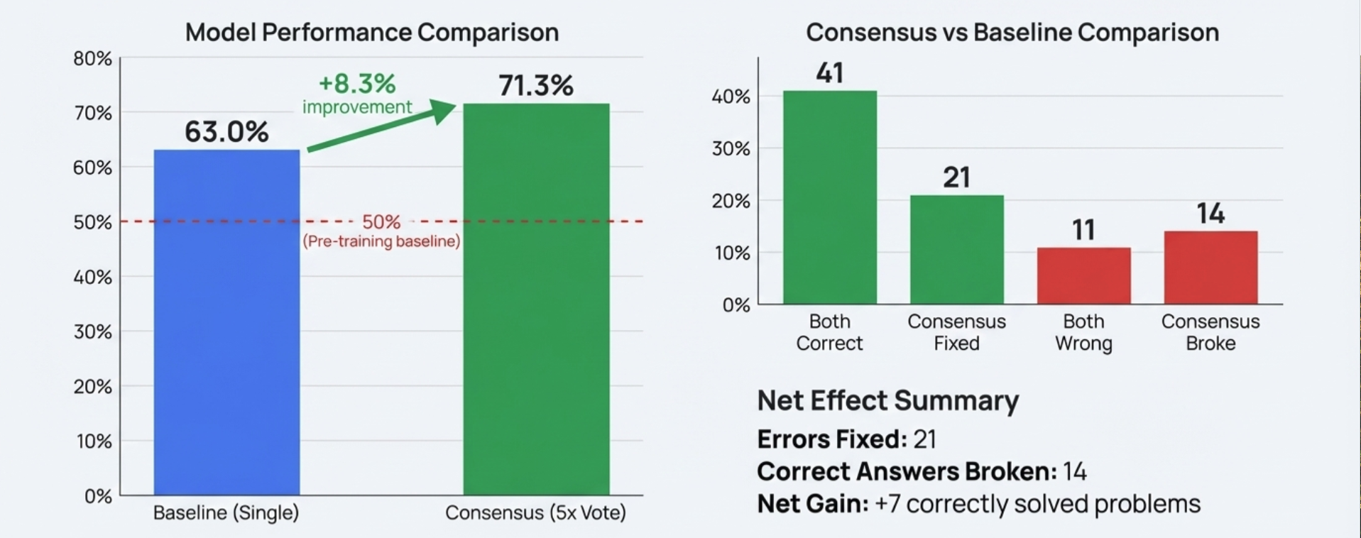
From Plateau to Peak Performance

Slide 12
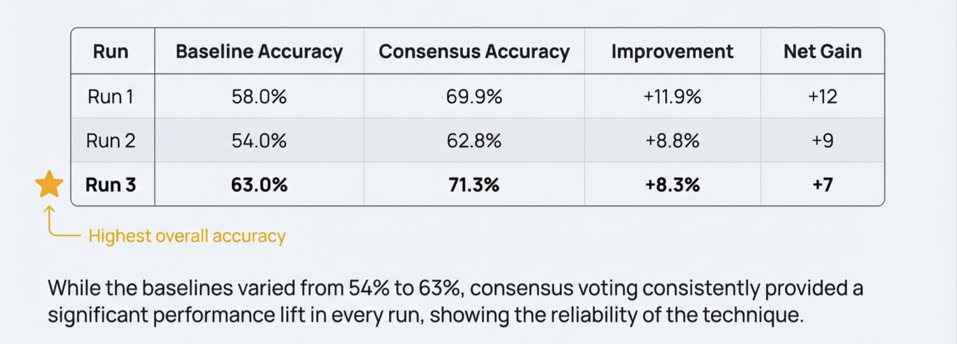
What did the Three Runs show us?

Slide 13
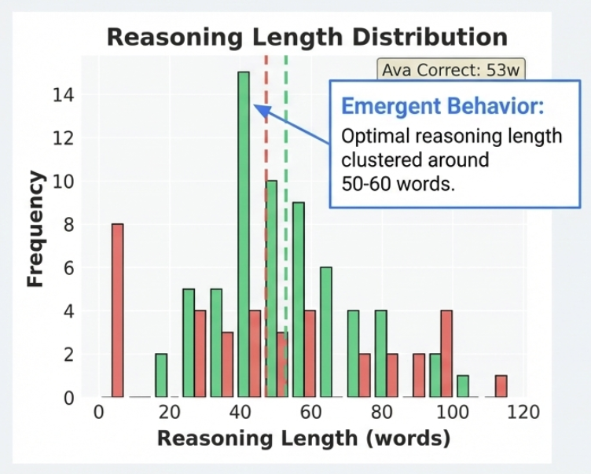
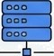



Key Insights and Emergent Behavior
GRPO enables RL on constrained hardware.
Process-based rewards improve reasoning quality.
Active Review is essential for multi-session stability.
Inference-time compute can significantly boost reliability.

Slide 14
Thank You
Questions ?

